Slide 1
Power
Song Chen
Dept. of Electronic Science and Technology
Nov. 5, 2015
http://staff.ustc.edu.cn/~songch/da-ug.htm

Slide 2
Outline
Power
  Power & Energy
  Dynamic Power
  Static Power (Leakage Power)
  Low Power Design Technologies

Slide 3

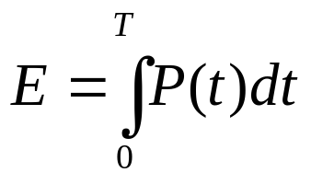
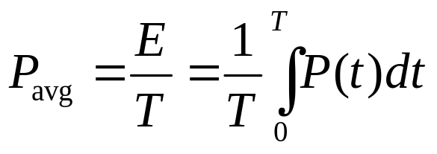
Power and Energy
Power is drawn from a voltage source attached to the V_{DD} pin(s) of a chip.
Instantaneous Power:
Energy:
Average Power:

Slide 4
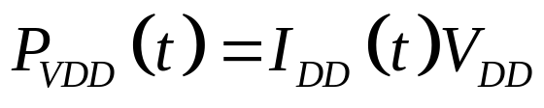
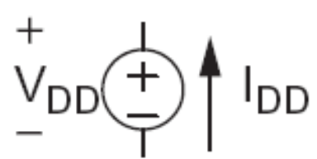
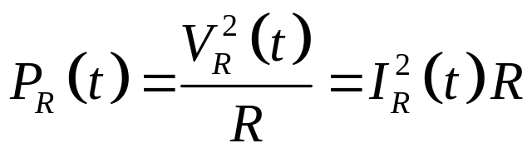
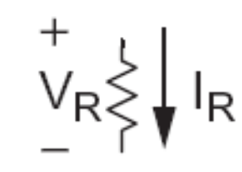
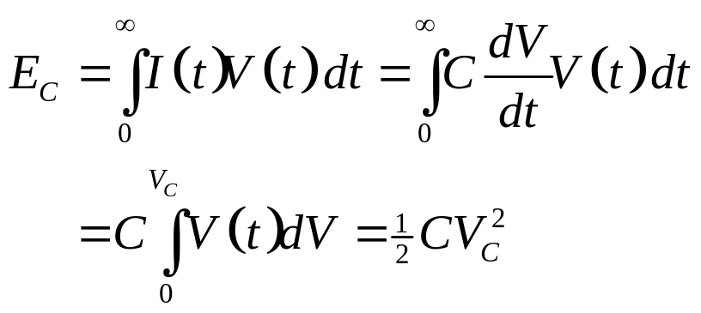

Power in Circuit Elements

Slide 5
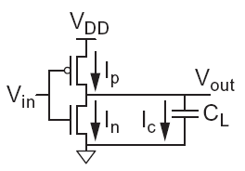

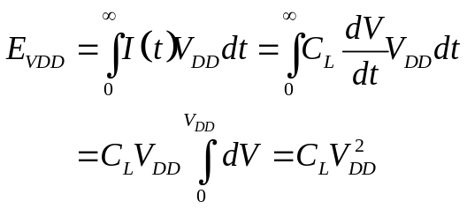
Charging a Capacitor
When the gate output rises
  Energy stored in capacitor is
  But energy drawn from the supply is
  Half the energy from V_{DD} is dissipated in the pMOS transistor as heat, other half stored in capacitor
When the gate output falls
  Energy in capacitor is dumped to GND
  Dissipated as heat in the nMOS transistor

Slide 6
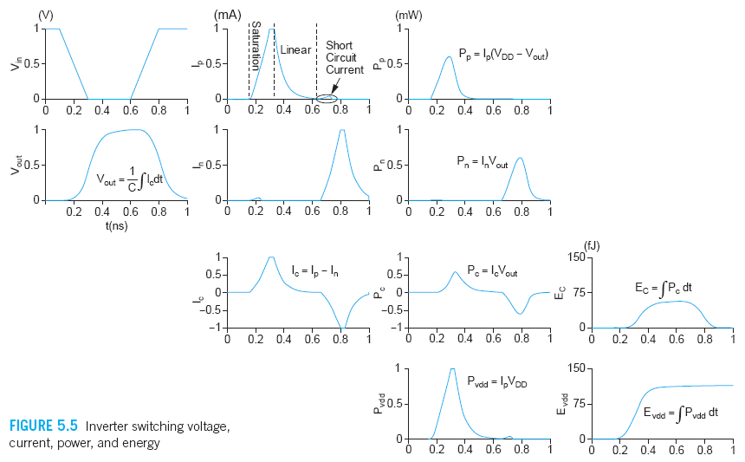
Switching Waveforms
Example: V_{DD} = 1.0 V, C_{L} = 150 fF, f = 1 GHz

Slide 7
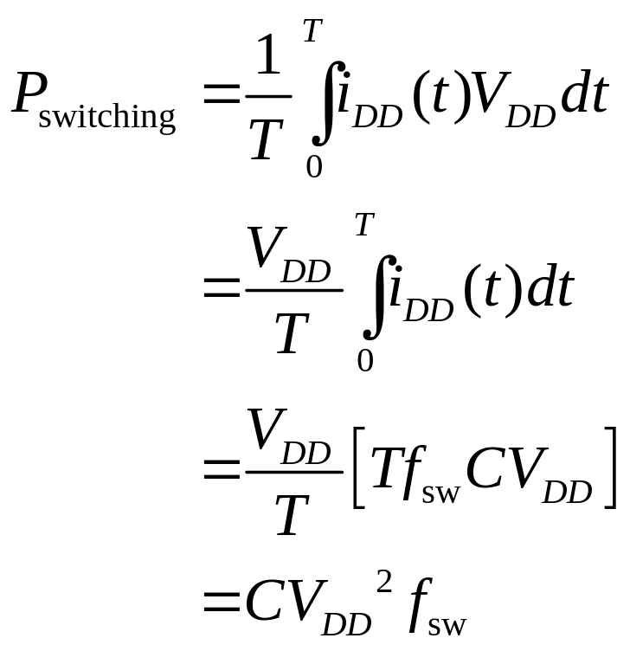
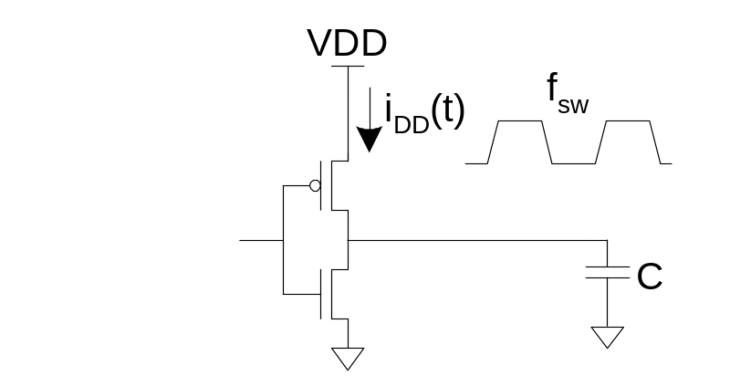
Switching Power

Slide 8
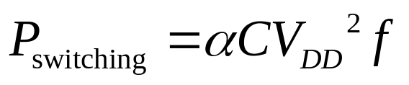
Activity Factor
Suppose the system clock frequency = f
Let f_{sw} = αf, where α = activity factor
  If the signal is a clock, α = 1
  If the signal switches once per cycle, α = ½
Dynamic power:

Slide 9
Short Circuit Current
When transistors switch, both nMOS and pMOS networks may be momentarily ON at once
Leads to a blip of “short circuit” current.
< 10% of dynamic power if rise/fall times are comparable for input and output
We will generally ignore this component

Slide 10
Power Dissipation Sources
P_{total} = P_{dynamic} + P_{static}
Dynamic :
P_{dynamic} = P_{switching} + P_{shortcircuit}
Static:
P_{static} = (I_{sub} + I_{gate} + I_{junct})V_{DD}
Power
Dynamic
Static (Leakage)
I_{sw}
I_{Int}
C_{load}
I_{Leakage}
Switching
Short Circuit
I_{sw}
I_{Int}
C_{load}
C_{load}

Slide 11
Dynamic Power Example
1 billion transistor chip
  50M logic transistors
    Average width: 12 λ (λ=25nm)
    Activity factor = 0.1
  950M memory transistors
    Average width: 4 λ
    Activity factor = 0.02
  1.0 V 65 nm process
  C = 1 fF/μm (gate) + 0.8 fF/μm (diffusion)
Estimate dynamic power consumption @ 1 GHz. Neglect wire capacitance and short-circuit current.

Slide 12
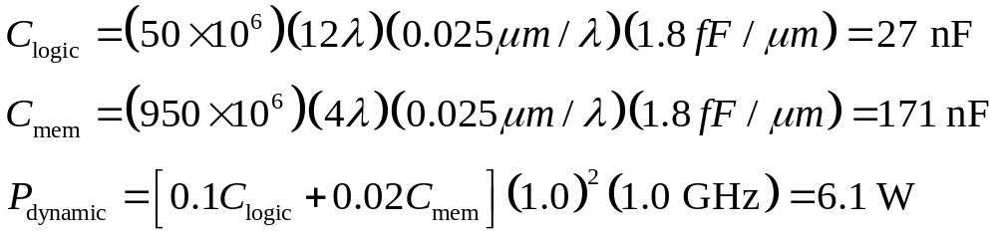
Solution

Slide 13
Dynamic Power Reduction
Try to minimize:
  Activity factor
  Capacitance
  Supply voltage
  Frequency

Slide 14
Activity Factor Estimation
Let P_{i} = Prob(node i = 1)
  P_{i} = 1-P_{i}
α_{i} = P_{i} * P_{i}
Completely random data has P = 0.5 and α = 0.25
Data is often not completely random
  e.g. upper bits of 64-bit words representing bank account balances are usually 0
Data propagating through ANDs and ORs has lower activity factor
  Depends on design, but typically α ≈ 0.1

Slide 15
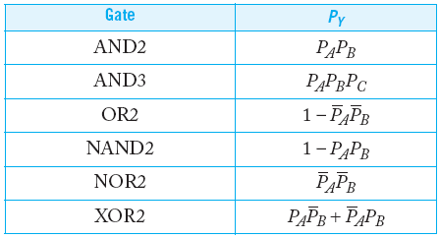
Switching Probability

Slide 16
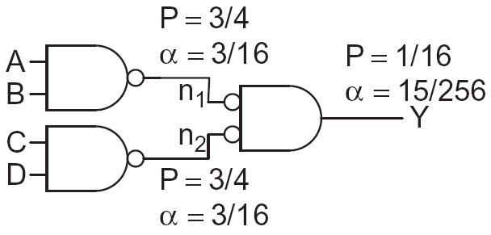
Example
A 4-input AND is built out of two levels of gates
Estimate the activity factor at each node if the inputs have P = 0.5

Slide 17
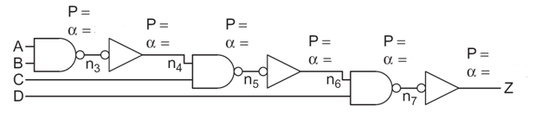
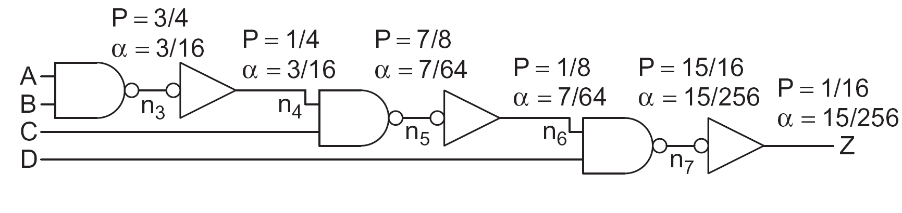
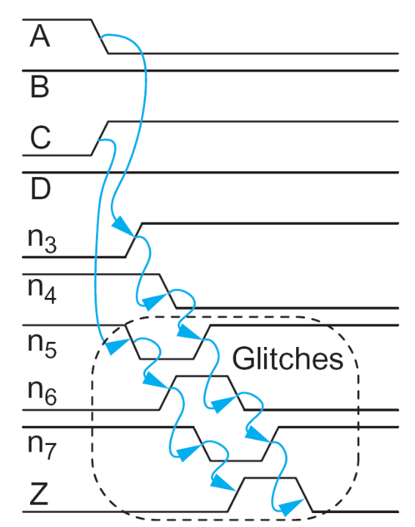
Example 2

Slide 18
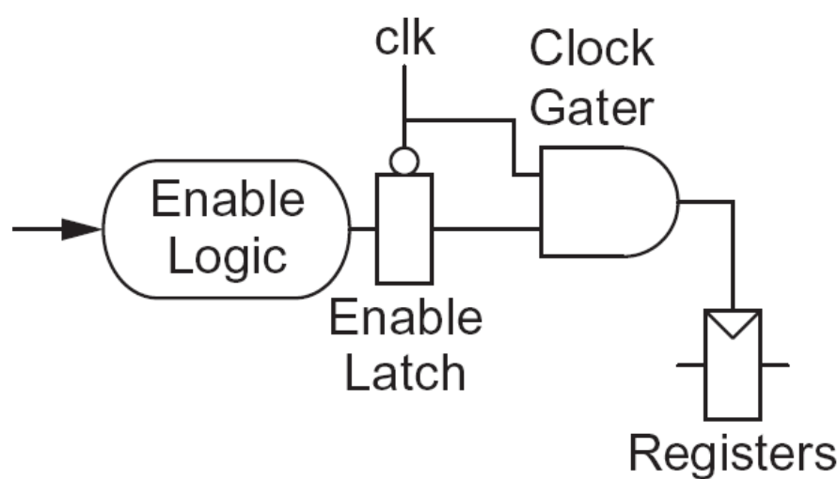
Clock Gating
The best way to reduce the activity is to turn off the clock to registers in unused blocks
  Saves clock activity (α = 1)
  Eliminates all switching activity in the block
  Requires determining if block will be used

Slide 19
Capacitance
Gate capacitance
  Fewer stages of logic
  Small gate sizes
Wire capacitance
  Good floorplanning to keep communicating blocks close to each other
  Drive long wires with inverters or buffers rather than complex gates
    [stan99] M. Stan, “Optimal Voltages and Sizing for Low Power”, Proc. Intl. Conf. VLSI Design, Jan. 1999, pp.428~433.

Slide 20
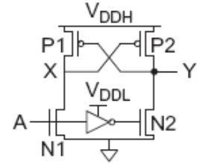
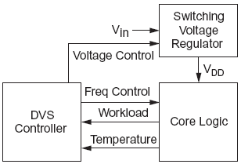
Voltage / Frequency
Run each block at the lowest possible voltage and frequency that meets performance requirements
Voltage Domains
  Provide separate supplies to different blocks
  Level converters required when crossing
  from low to high V_{DD} domains
Dynamic Voltage Scaling
  Adjust V_{DD} and f according to
  workload

Slide 21




Multi-Voltage Design Techniques
Level Shifters
0.7 – 1.08
Level Shifter
logic model
VDD1
VDD2
LS
LS
LS
LS
0.9
0.7
IN
OUT
LS
LS
VSS
Notes:
In multi-voltage design signals that go between blocks that use different voltage level require buffers that able to shift a signal that comes in at one voltage level to an output that is at a different voltage level and vice versa. These are called level shifters.

Slide 22


Voltage vs. Delay
How delay will vary if the supply or threshold voltage is changed?
  Scaling of the RC time constant and of gate delay
  As transistors become more velocity saturated, increasing Vgs has less effect on current and α decreases, reaching 1 for transistors that are completely velocity saturated.

Slide 23
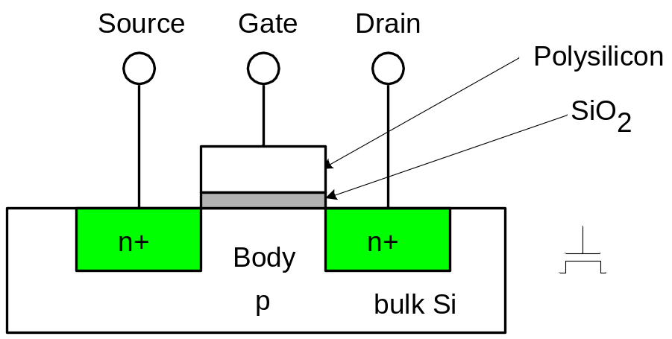
Static Power
Static power is consumed even when chip is quiescent (not switching).
  Sub-threshold leakage
  Gate leakage
  Junction Leakage (negligible)

Slide 24
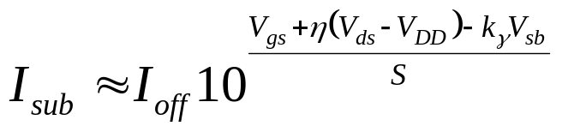
Subthreshold Leakage
For V_{ds} > 50 mV
I_{off} = leakage at V_{gs} = 0, V_{ds} = V_{DD}
Typical values in 65 nm
I_{off} = 100 nA/μm @ V_{t} = 0.3 V
I_{off} = 10 nA/μm @ V_{t} = 0.4 V
I_{off} = 1 nA/μm @ V_{t} = 0.5 V
η = 0.1
k_{γ} = 0.1
S = 100 mV/decade

Slide 25







Multi-Threshold Design Example
Multi-V_{t} libraries enable low leakage design
Low Vt
High Vt
FF
FF
Critical Path
FF
FF
FF
Notes:
Here is an example.
This circuit contains cells with both low and high threshold voltage. Low VT devices (white) are used in critical paths as delay on this path should be the smallest and low-VT devices provide small device but consume more power. In other parts of circuit high VT devices (yellow) are used to minimize leakage power, though they have larger delays but as delay of circuit is defined by critical path, small amount of delay increase does not affect functionality.
To achieve the necessary timing accuracy, path-delay calculations need to include interconnect delays based on cell placement and net routing information. This is why these methodology is commonly implemented during physical design stage.
Multi-threshold design can be implemented using cells having more than two threshold voltages, in practical examples it is common to use between 2 and 5 threshold types. Although Dual-Vth methodologies are more common because of ease of fabrication.

Slide 26
Static Power Example
Revisit power estimation for 1 billion transistor chip
Estimate static power consumption
  Subthreshold leakage
    Normal V_{t}: 100 nA/μm
    High V_{t}: 10 nA/μm
    High Vt used in all memories and in 95% of logic gates
  Gate leakage 5 nA/μm
  Junction leakage negligible

Slide 27
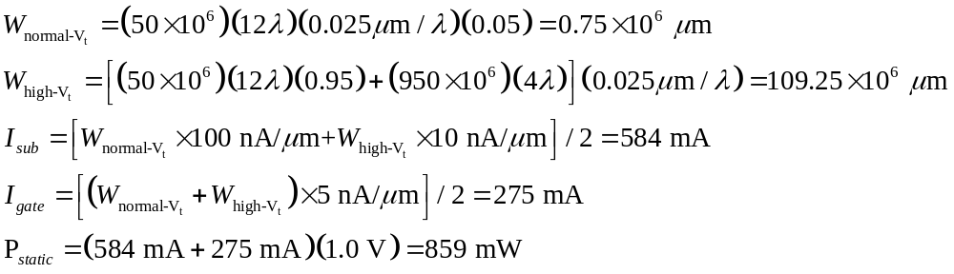
Solution

Slide 28
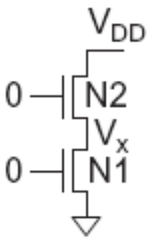
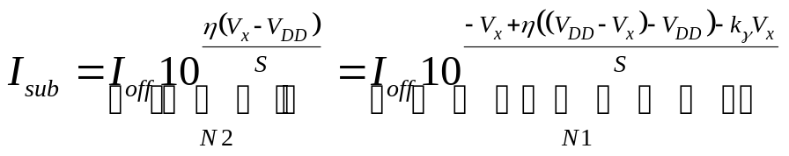
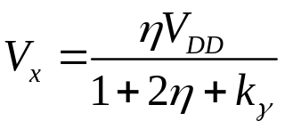
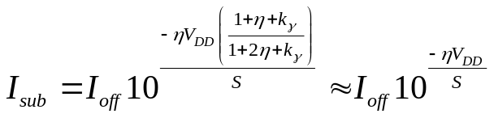
Stack Effect
Series OFF transistors have less leakage
  V_{x} > 0, so N2 has negative V_{gs}
  Leakage through 2-stack reduces ~10x
  Leakage through 3-stack reduces further

Slide 29
Leakage Control
Leakage and delay trade off
  Aim for low leakage in sleep and low delay in active mode
To reduce leakage:
  Increase V_{t}: multiple V_{t}
    Use low V_{t} only in critical circuits
  Increase V_{s}: stack effect
    Input vector control in sleep
  Decrease V_{b}
    Reverse body bias in sleep
    Or forward body bias in active mode

Slide 30
Gate Leakage
Extremely strong function of t_{ox} and V_{gs}
  Negligible for older processes
  Approaches subthreshold leakage at 65 nm and below in some processes
An order of magnitude less for pMOS than nMOS
Control leakage in the process using t_{ox} > 10.5 Å
  High-k gate dielectrics help
  Some processes provide multiple t_{ox}
    e.g. thicker oxide for 3.3 V I/O transistors
Control leakage in circuits by limiting V_{DD}

Slide 31
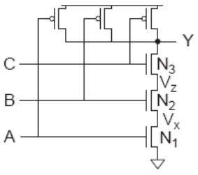
NAND3 Leakage Example
100 nm process
  I_{gn} = 6.3 nA I_{gp} = 0
  I_{offn} = 5.63 nA I_{offp} = 9.3 nA
Data from [Lee03]

Slide 32
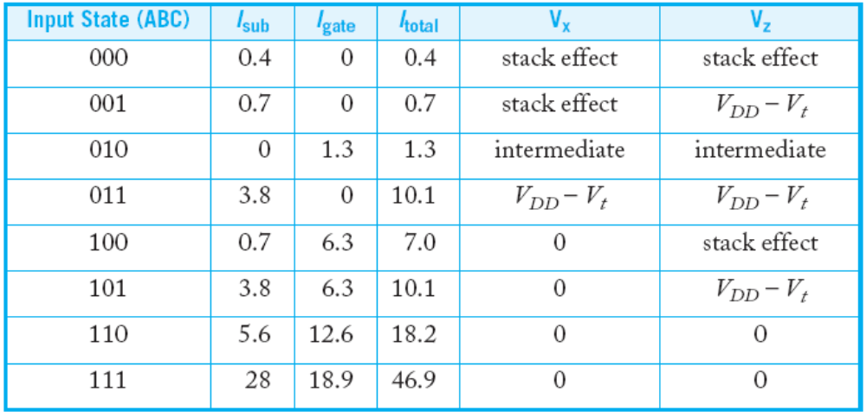
NAND3 Leakage Example
100 nm process
  I_{gn} = 6.3 nA I_{gp} = 0
  I_{offn} = 5.63 nA I_{offp} = 9.3 nA
2.0
3.8
Data from [Lee03]

Slide 33
Junction Leakage
From reverse-biased p-n junctions
  Between diffusion and substrate or well
Ordinary diode leakage is negligible
Band-to-band tunneling (BTBT) can be significant
  Especially in high-V_{t} transistors where other leakage is small
  Worst at V_{db} = V_{DD}
Gate-induced drain leakage (GIDL) exacerbates
  Worst for V_{gd} = -V_{DD} (or more negative)
  Pls. refer to Chapter 2.4.3 & Chapter 5.3 of Reference 3 for more details.

Slide 34
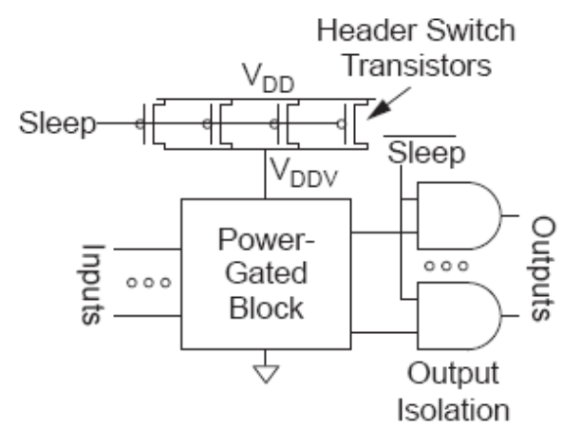
Power Gating
Turn OFF power to blocks when they are idle to save leakage
  Use virtual V_{DD} (V_{DDV})
  Gate outputs to prevent
  invalid logic levels to next block
Voltage drop across sleep transistor degrades performance during normal operation
  Size the transistor wide enough to minimize impact
Switching wide sleep transistor costs dynamic power
  Only justified when circuit sleeps long enough

Slide 35
Power Gating: retention register
Retention Register preserve status
while the logic is turned off
1.08V/OFF
RR
RR
RR
CTR
1.08V/OFF
0.7V
sleep
0.9V
Coarse Grain (switch cells)
Notes:
In order to implement power gating technique two type of cells are required. As was discussed in previous section ace ll called power gating is required for turning blocks on and off.
But there is another issue, if block is shut down its state needs to be retained, for this purpose state retention registers are used. These registers have a backup power supply connection that remains always on to hold the state of the register when the block is shut off.

Slide 36
Low Power Design Techniques
0.9V
REG
0.7 – 1.08V
CTRL
0.7V
0.9V
0.7V
0.9V
Adaptive Voltage
Scaling (AVS)
Static Multi Voltage (MV)
0.9V
PWR
CTRL
0.7 – 0.9V
OFF
0.7V
0.9V
0.7V
OFF
0.9V
MV with power gating
Dynamic Voltage/Frequency
Scaling (DVFS)
Notes:
Another method based on different activity profile of different blocks is Multi Voltage technique. This technique is based on the fact that if voltage of block will be lowered it would consume less power but will loose performance. Thus optimal tradeoff between power and performance could be found applying different voltages to different blocks.
The simplest multi-voltage technique is where multiple voltages are used for different blocks of a design but the voltages remain constant during all modes of operation. This is called static multi-voltage.
There are a various modifications of Multi-Voltage Design Techniques.
First technique is multi-voltage with power gating. For this technique multiple voltages are used for different blocks of a design and, for some modes of operation, switch cells are used to shut down the power to some non-critical functionality blocks. This is implemented the same way as Power gating technique already discussed.
Another technique is dynamic voltage scaling and frequency scaling. In this method a power controller is used and, depending on the required performance, the supply voltage on certain blocks can be increased or decreased during normal operation to conserve power. When the supply voltage is lowered on a block, its operating frequency may need to be lowered to maintain its functionality. In addition, if blocks are non-critical for a functional mode they can be turned off altogether.
More complex case of dynamic voltage scaling and frequency scaling is adaptive voltage and frequency scaling. Adaptive voltage scaling, as its name implies, can adapt to changing on-chip conditions or performance requirements. As such it requires on-chip control and a voltage regulator whereas dynamic voltage scaling is typically controlled via a power controller block. In this example, the voltage regulator is capable of providing a high number of discrete voltage levels between 0.7 V and 1.08 V.

Slide 37
Reference
Reference 3. Chapter 5

